Slide 1
SIDE by SIDE Discussion: Designing Space Science Student Camps Focused on the Eclipse
Gerald Knezek and Rhonda Christensen
University of North Texas
iittl.unt.edu

Slide 2
Introduction
August 21, 2017 will be the first time a total eclipse of the sun will be visible in the continental United States for more than 35 years
Need to prepare and interest students for future STEM careers and particularly NASA careers such as space science
https://eclipse2017.nasa.gov
Good Overview: TEDEd 4 minute video
  What creates a total solar eclipse (by Andy Cohen)
  https://www.youtube.com/watch?v=Qog18tiNnqg

Slide 3
Research Questions
To what extent do students who attended a four-hour space science camp gain in their knowledge of and enthusiasm for eclipse-related activities?
How does the treatment group of students compare to students in the same school who did not attend the camp?

Slide 4
Participants
Twenty 6th grade students from a rural school district attended a four-hour long Saturday Space Science Camp at a nearby university that focused on solar eclipse activities.
Pre-test and post test data were collected from the 20 students as well as a comparison group of students who did not attend the camp.

Slide 5
Instrumentation
Dispositions toward space science and the eclipse
8 Content questions regarding the eclipse

Slide 6
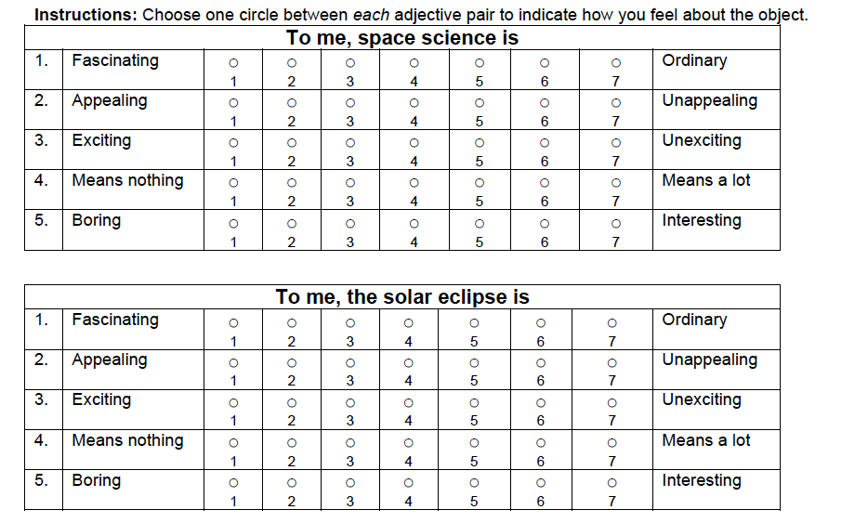
Dispositions

Slide 7
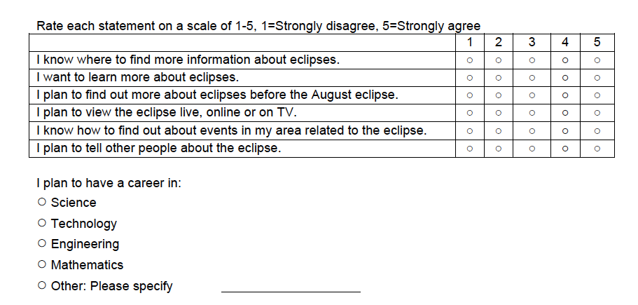
Enthusiasm for Solar Eclipse

Slide 8
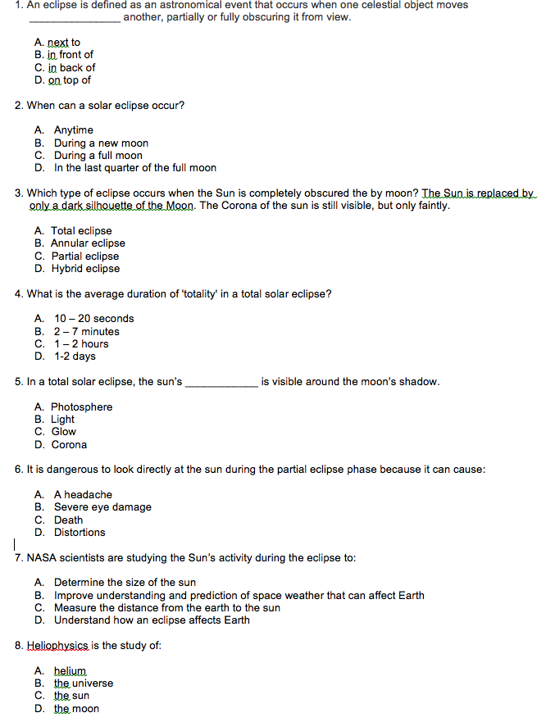
Content Items

Slide 9
Activities
Scale modeling
  Students were presented with the challenge of making a physical model of a portion of our solar system that included the Sun, the Earth, and the Moon for the purpose of demonstrating how a solar eclipse occurs.
Augmented Reality and Virtual Reality
  Students were introduced to the general concepts of Augmented Reality (AR) and Virtual Reality (VR) to better understand the differences between the two technologies, and then were taken through activities that enabled them to see the technologies in action.
2D Printing
  Students were given four different options for a glasses frame design to print. The Silhouette software was used to print and cut the glasses frames.
3D Printing
  Students were introduced to 3D modeling using a cloud-based computer aided design software – Tinkercad. Students were invited to take a closer look at three different 3D printers and examined different parts of a 3D printer: print bed, extruder, motors and spools of filaments that feed to print 3D models. Students took home a 3D printed model of the solar system.

Slide 10
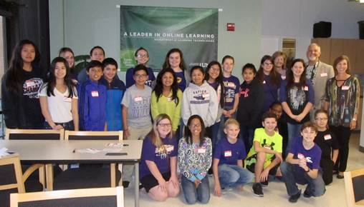
Camp Participants

Slide 11
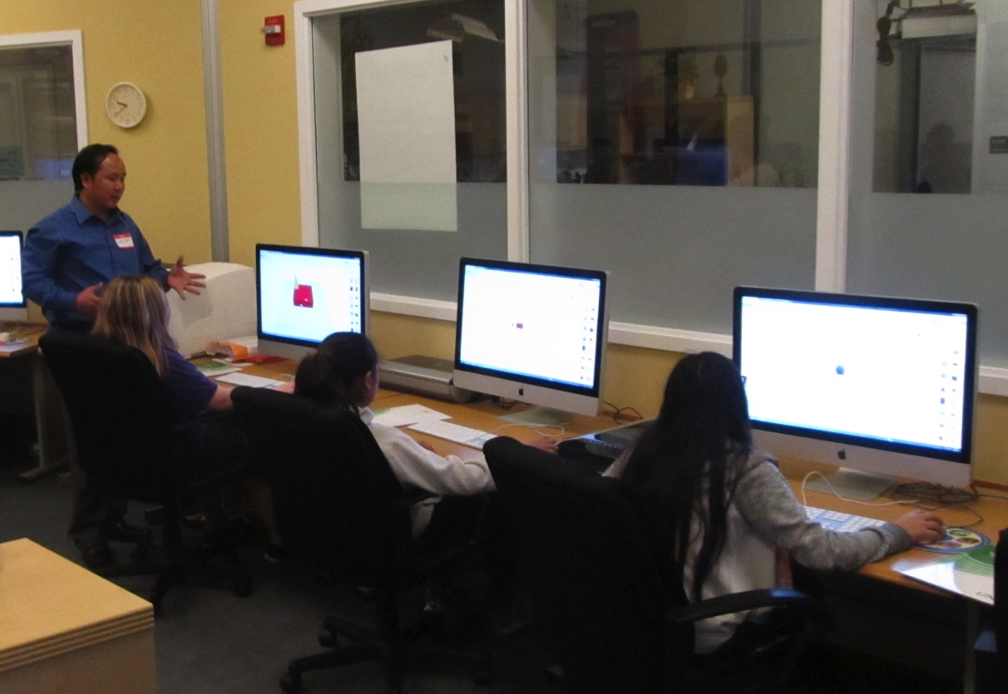
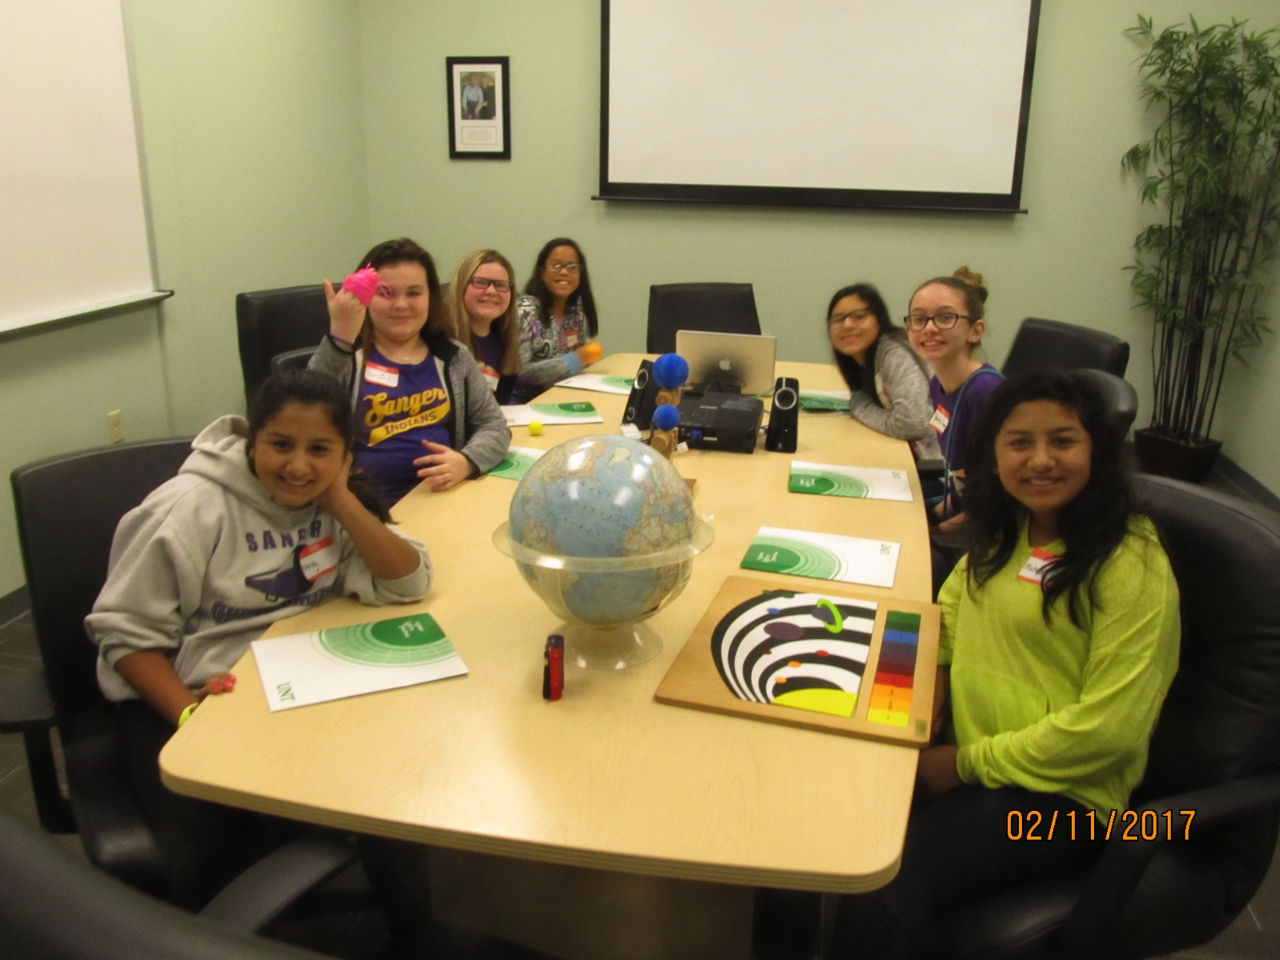
Camp Activities
Tinkercad 3D Exploration
Scale Modeling

Slide 12
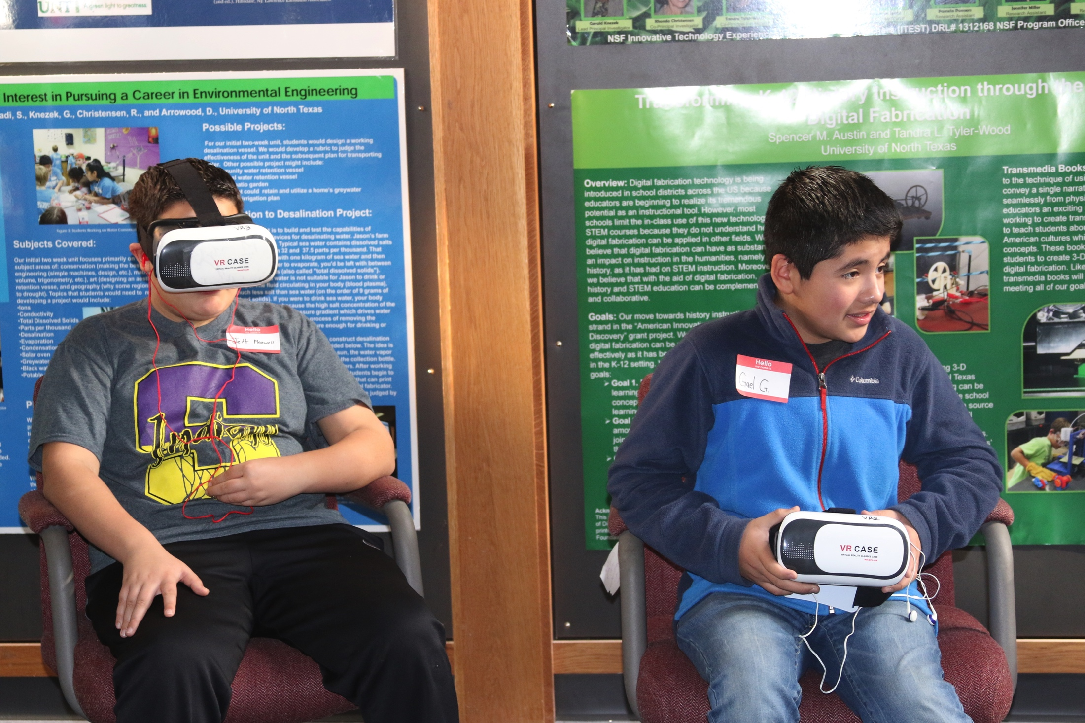
Virtual Reality

Slide 13
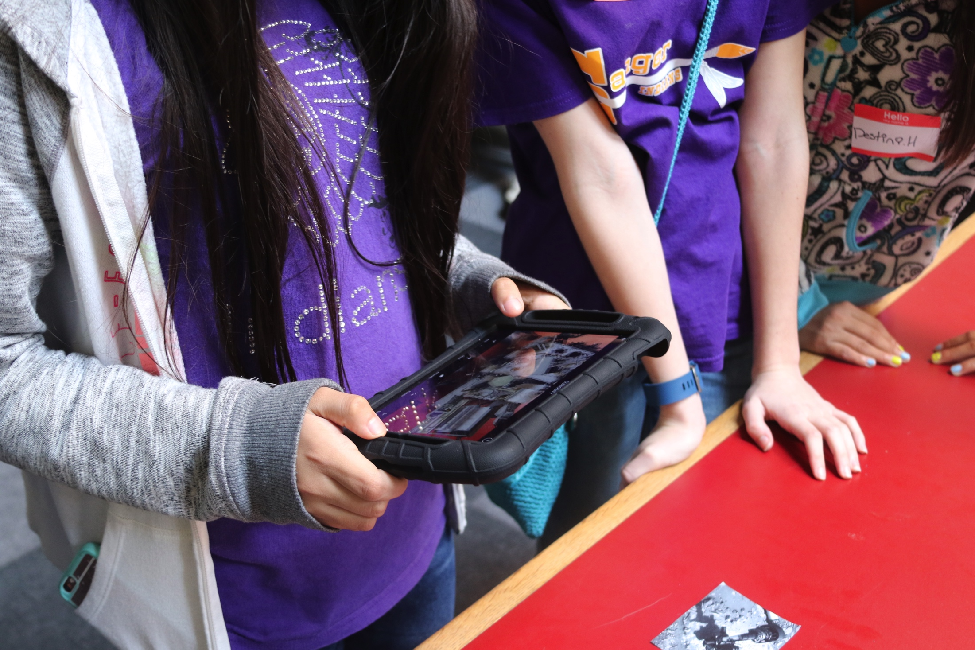
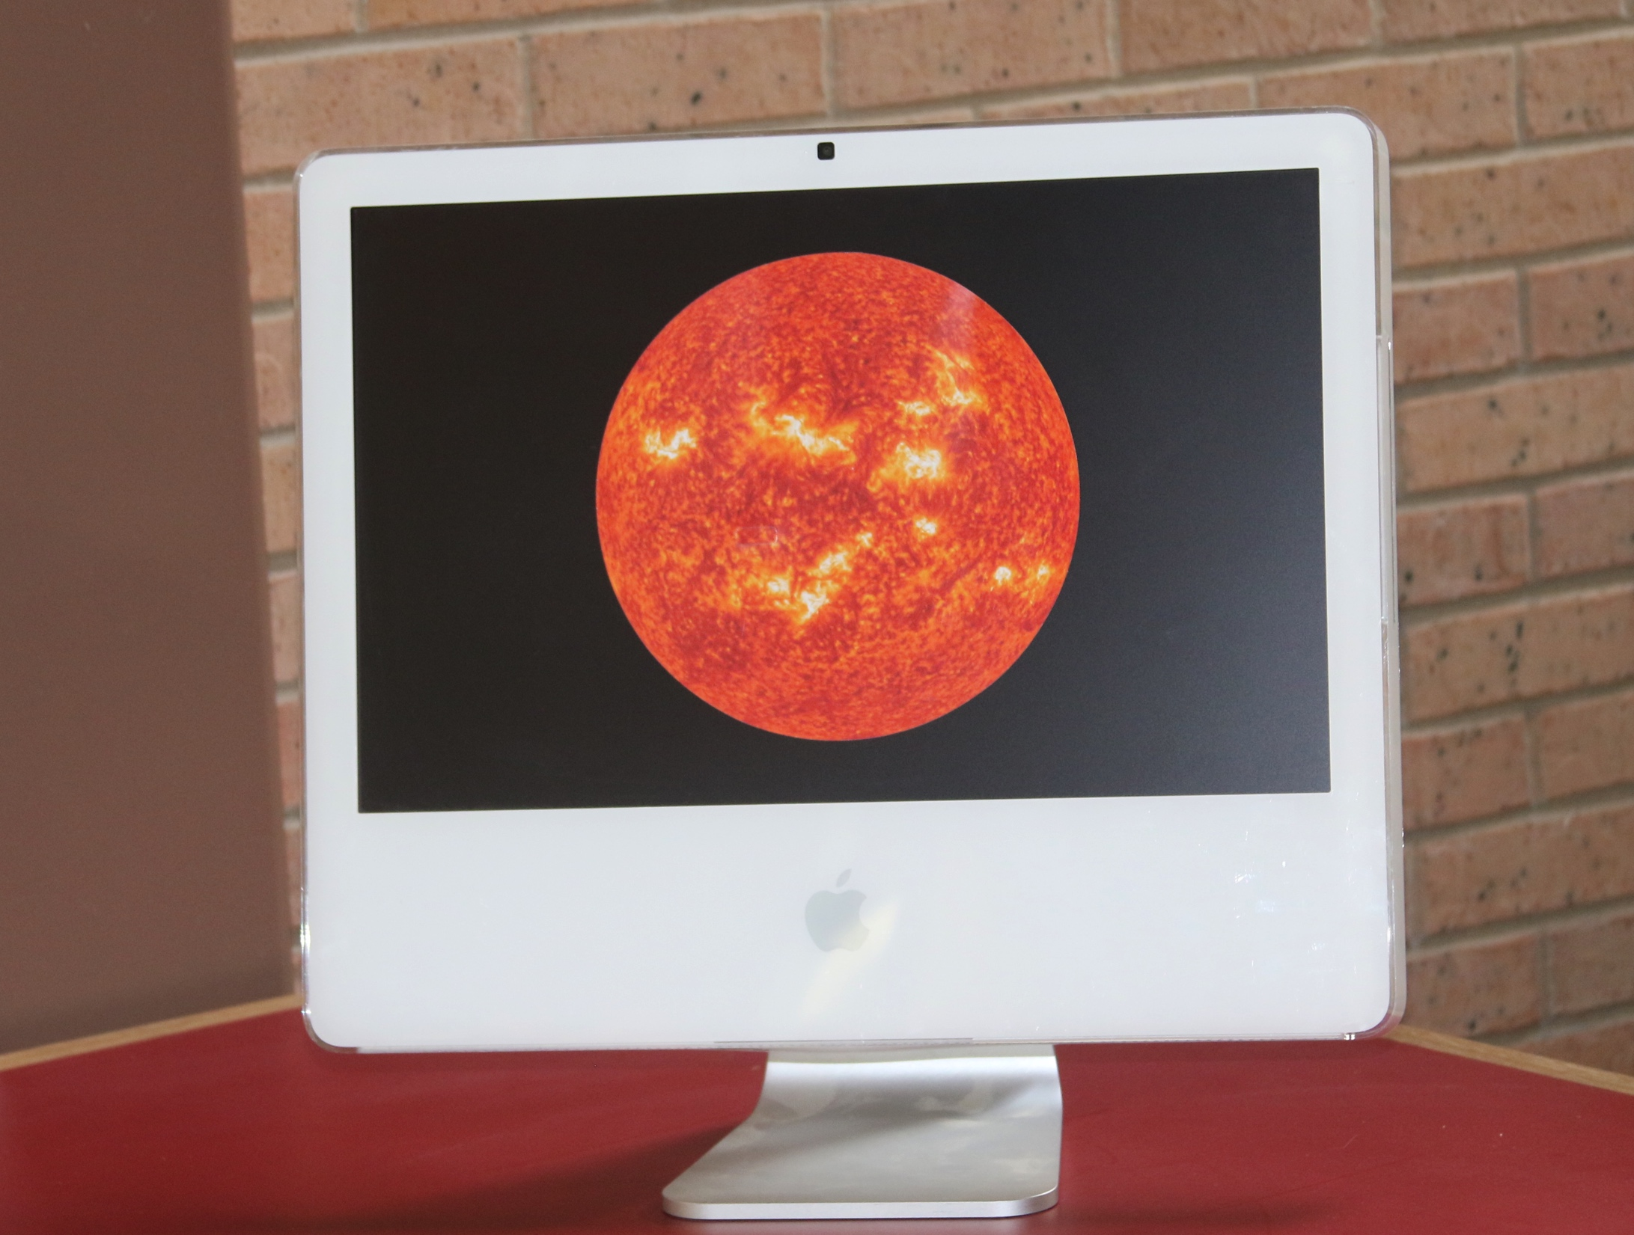
Augmented Reality

Slide 14
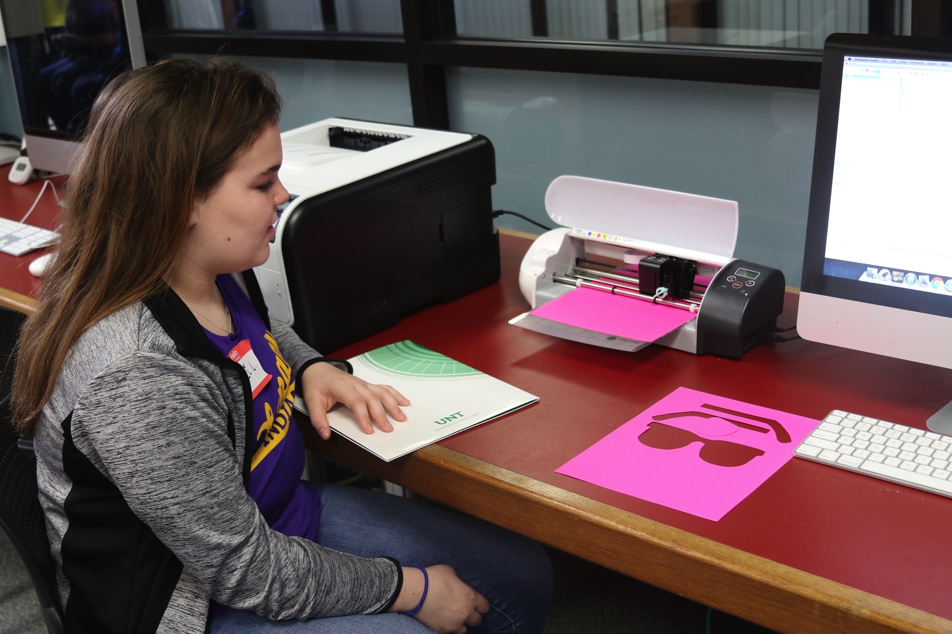
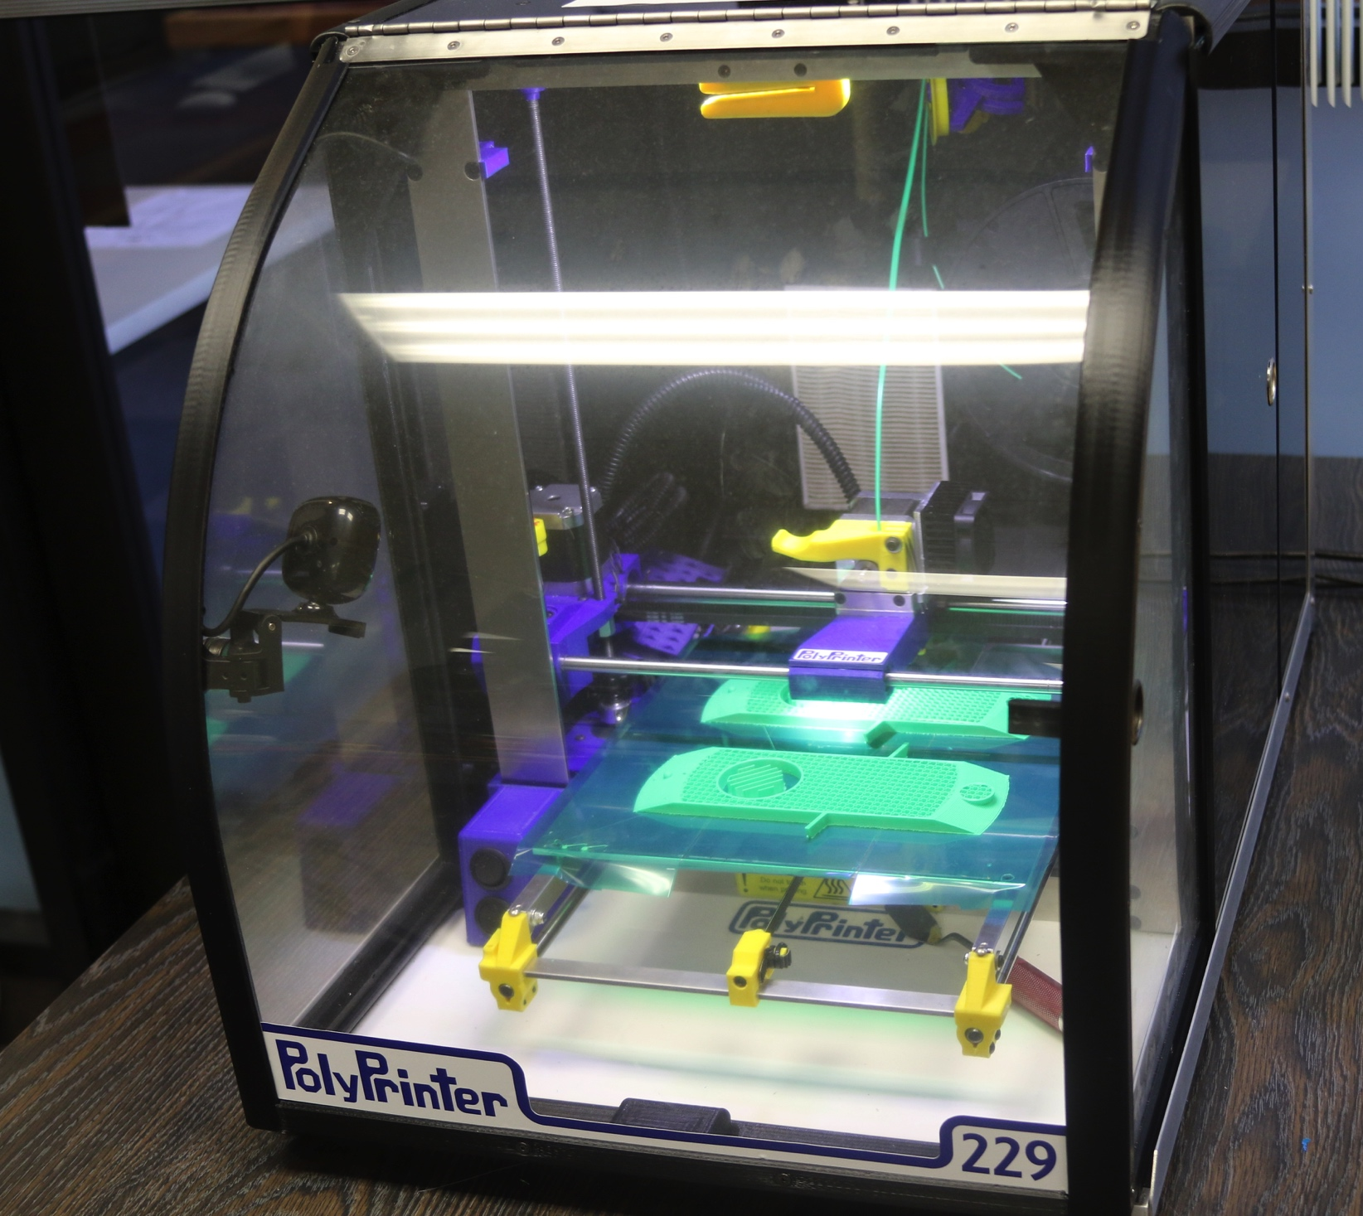
Silhouette 2D Printing
Polyprinter 3D Printing

Slide 15
Results
Paired pre-post treatment students’ gains in content were significant (p = .002)
 | N | Mean | SD | Sig. | Cohen’s d
Eclipse pre | 20 | 3.80 | 1.67
Eclipse post | 20 | 5.40 | 1.14 | .002 | 1.12

Slide 16
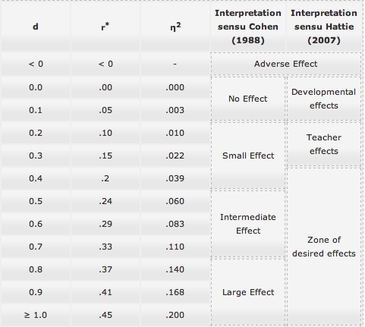
Psychometrika 2014

Slide 17
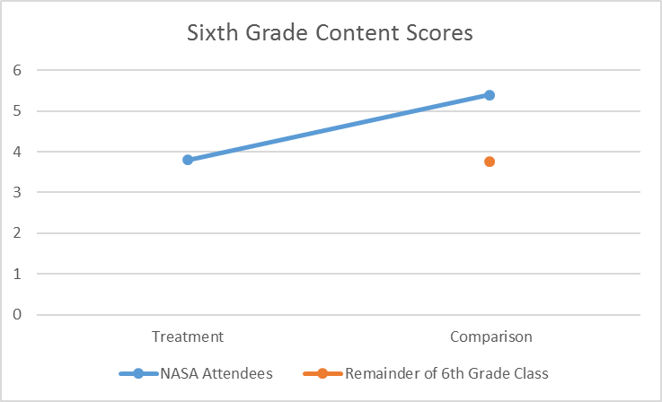
Treatment Vs. Comparison (Post Camp)
 | N | Mean | SD | Sig.
Did not Attend | 176 | 3.77 | 1.52
Attended Camp | 20 | 5.40 | 1.14 | .0005

Slide 18
Gender Differences
 |  | N | Mean | SD | Sig. | Cohen’s d
Male | Eclipse Pre | 8 | 4.38 | 1.77
 | Eclipse Post | 8 | 5.88 | .64 | .064 | 1.13
Female | Eclipse Pre | 12 | 3.42 | 1.56
 | Eclipse Post | 12 | 5.08 | 1.31 | .019 | 1.15

Slide 19
Conclusions
Students who attended a four-hour space science camp focused on the solar eclipse gained a great deal of knowledge participating in hands-on innovative technology activities.
Some gender differences in content knowledge both in the pre-test as well as how much they gained.
All students appeared to be engaged in their learning activities and reported enjoying the camp.
It was observed that the hands-on aspect of the activities appeared to foster better engagement with the content.

Slide 20
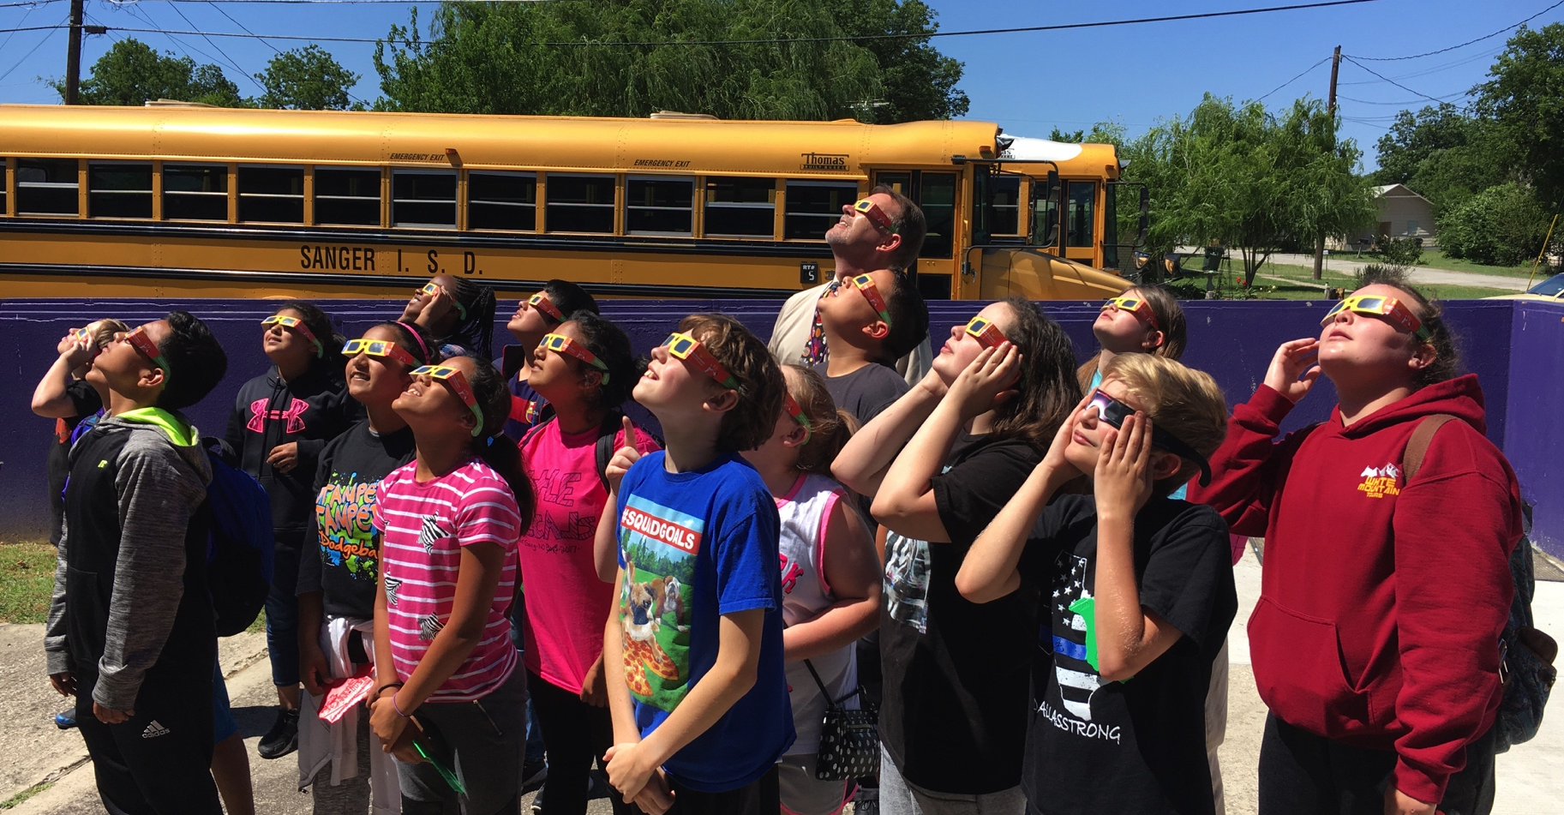

Slide 21
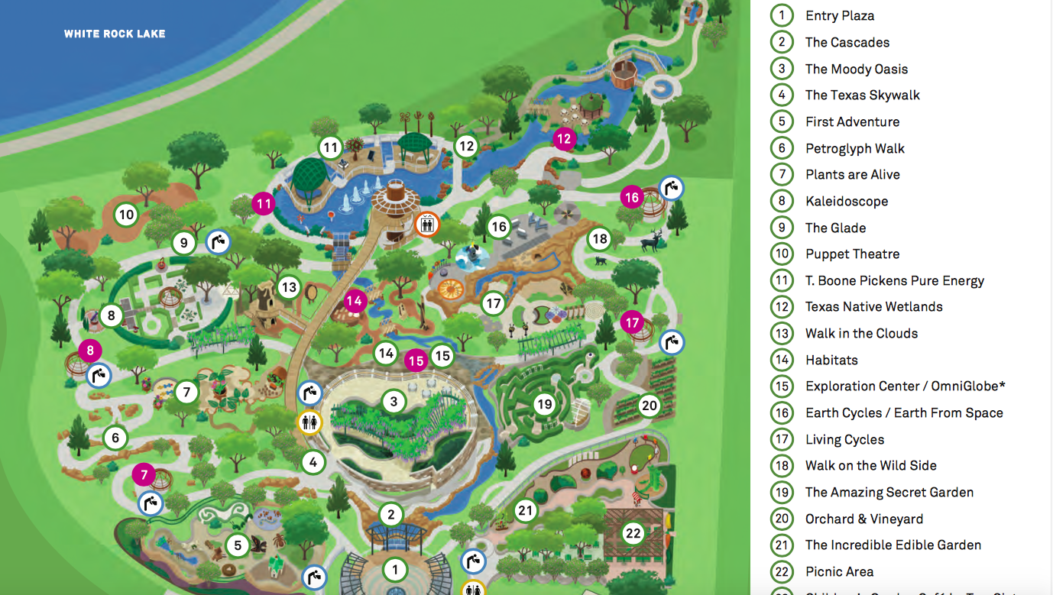
Next Stop: Dallas Arboretum Summer Camp July 2017
http://www.dallasarboretum.org/events-education/summer-camps#panel-11

